Slide 1




Introduction to Git and GitHub
Git and GitHub are essential tools for version control and collaborative software development.
Git is a distributed version control system, while GitHub is a web-based platform for hosting and collaborating on Git repositories.
by Niwesh Waiba

Slide 2
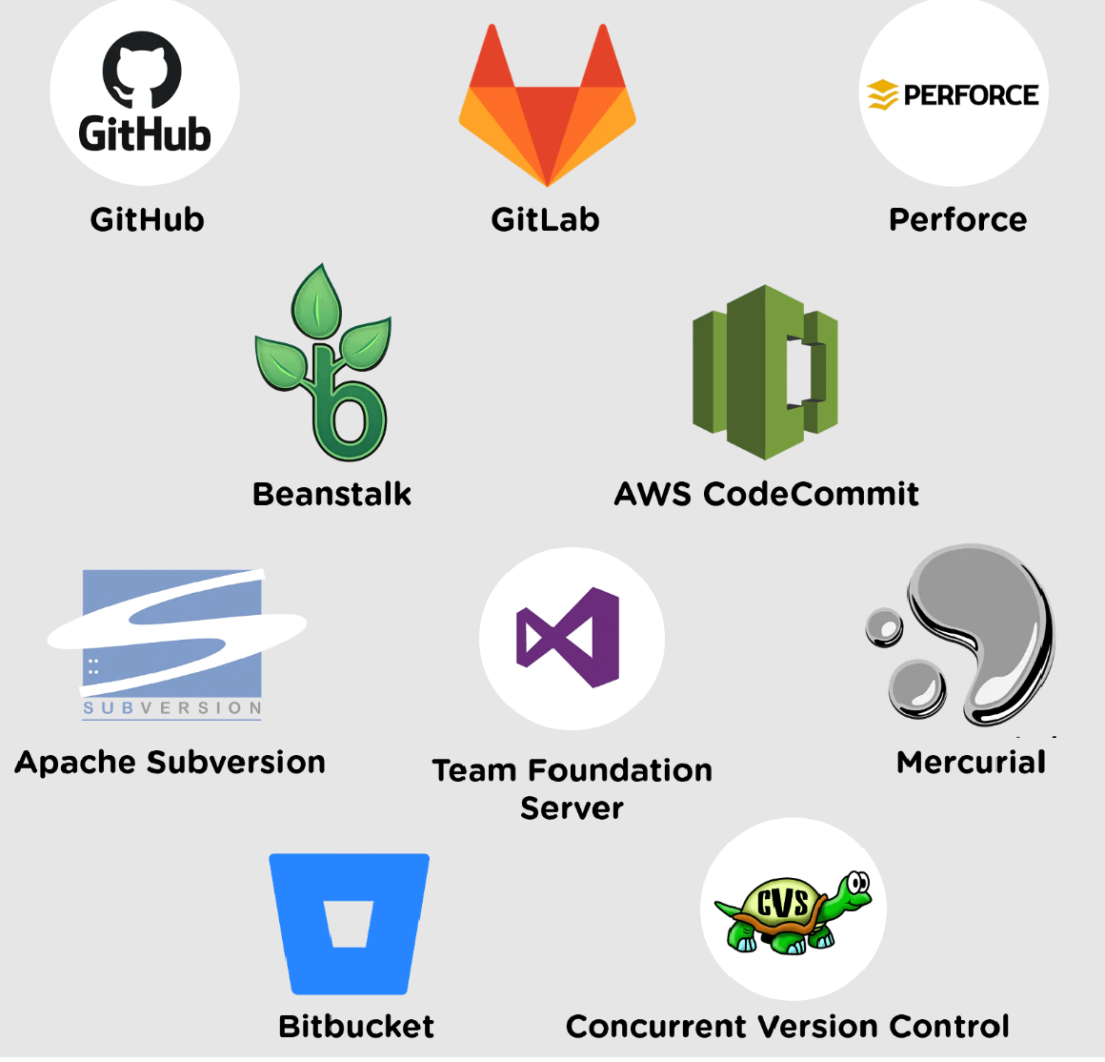
What is version control?
Version control is a system that records changes to a file or set of files over time so that you can recall specific versions later. It allows you to revisit earlier versions of a file, track changes, and collaborate with others seamlessly.

Slide 3
Benefits of using Git and GitHub
Efficient Collaboration
Version Control
Git and GitHub enable seamless collaboration among team members, allowing for easy sharing and reviewing of code.
With Git, you can track changes made to your code and revert to previous versions if needed, ensuring project stability.
Remote Access
Open Source Community
GitHub provides a platform for remote access to repositories, allowing developers to work from anywhere with an internet connection.
GitHub hosts a vibrant open-source community, offering opportunities for learning, collaboration, and contributing to projects.

Slide 4

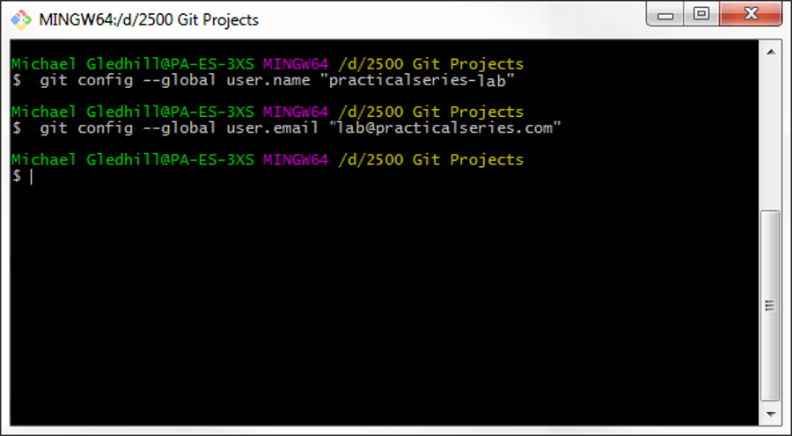
Setting up
Git and GitHub
Setting up Git involves installing Git on your computer and configuring it to work with your GitHub account.
You'll need to set up your identity, configure your text editor, and authenticate with GitHub to get started.
Additionally, understanding Git configuration settings and repository initialization is essential.

Slide 5
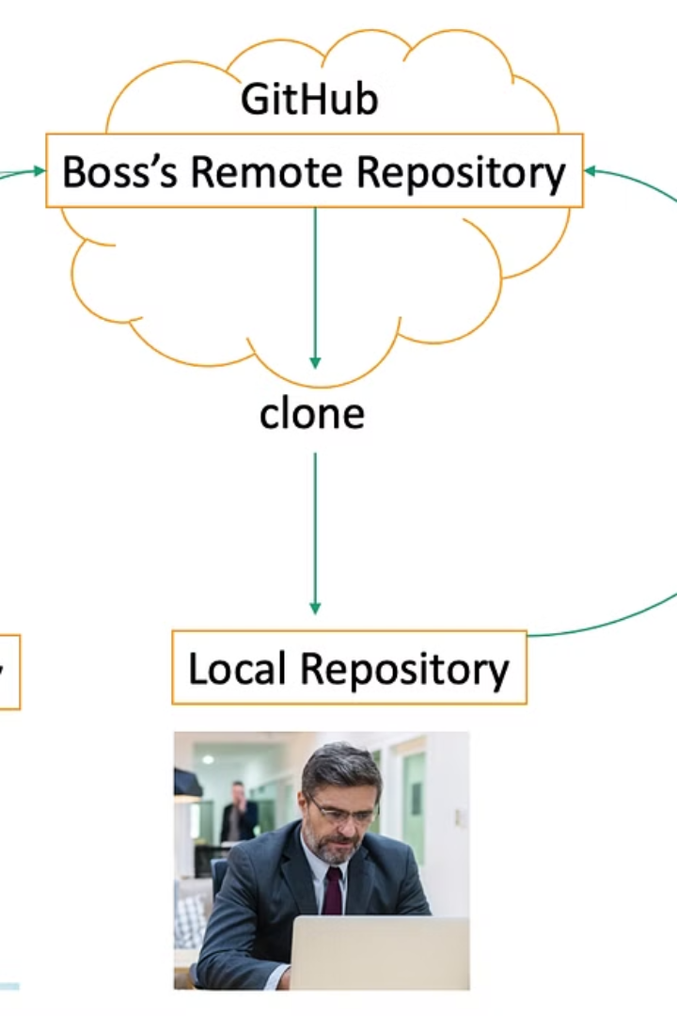
Basic Git commands
git clone: Clones an existing Git repository from a specified URL to your local machine.
git init: Initializes a new Git repository
git status: Shows the status of changes as untracked, modified, or staged
git add: Adds changes to the staging area
git commit: Records changes to the repository
git push: Pushes committed changes from your local repository to a remote repository

Slide 6



Clone Repository
Local Access
Team Collaboration
Cloning a repository creates a local copy of the remote repository on your computer for easy access and collaboration.
Once cloned, you can work on the files locally and push changes to the remote repository when ready.
Cloning allows team members to have their own local copies, enabling simultaneous work on different features.

Slide 7
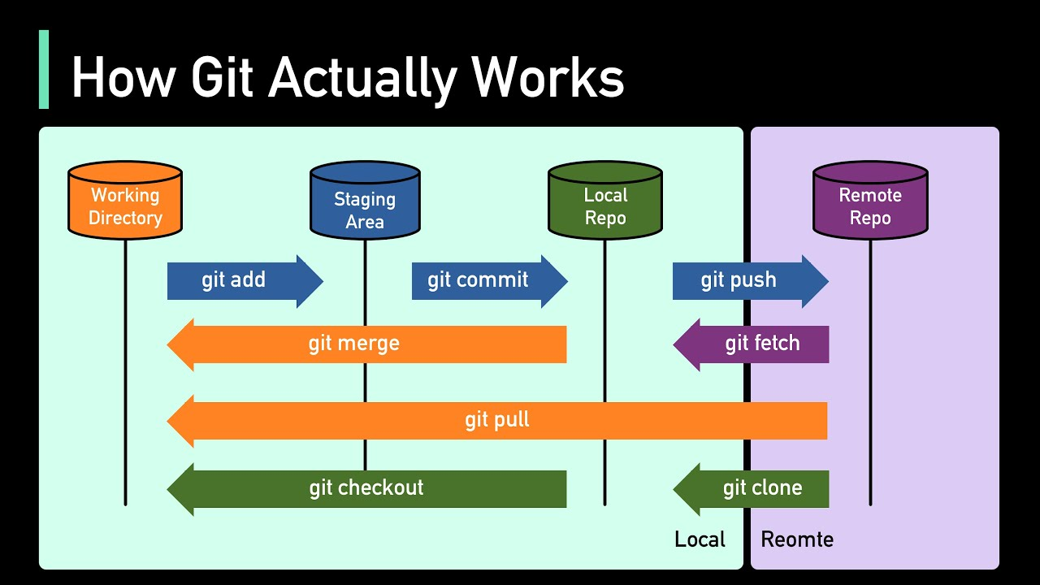

Slide 8




Branching and Merging
Branching
Merging
Conflict Resolution
Allows for creating separate lines of development for different features or bug fixes.
Bringing the changes from one branch into another, often used to combine feature branches into the main branch.
Handling conflicts that arise when the same part of a file is changed in different branches.

Slide 9
Collaborating on GitHub
Feature
Benefits
Branching
Enables parallel development and experimentation.
Merging
Integrates changes from one branch to another.
Pull Requests
Facilitates code review and collaboration.
Issues
Tracks tasks, enhancements, and bugs.

Slide 10
Best practices and tips
1
2
Commit Frequently
Use Descriptive Commit Messages
Create small, focused commits to track changes effectively.
Explain the purpose of the commit clearly and concisely.
3
4
Branch Naming Convention
Protect the Main Branch
Adopt a consistent naming convention for branches to enhance clarity.
Prevent direct commits to the main branch to maintain stability.

Slide 11
Conclusion and Further Resources
In conclusion, Git and GitHub provide powerful tools for version control and collaboration in software development. They also offer a wealth of resources for learning and development. Further resources include online tutorials, community forums, and documentation. Explore these to enhance your understanding and mastery of Git and GitHub.
Useful links:
https://git-scm.com/downloads
https://git-scm.com/book/en/v2
https://github.com/Niwesh-waiba/BIM_First_Git_Repo

